Slide 1
Systems Biology 2021 internship data analysis assignment
Michelle Meier
MSc Systems Biology, ETH Zurich

Slide 2
Workflow
get all info I need from GEO (research and meta data prep)
normalisation and quality control (edgeR)
Overview of data: Is there anything interesting?
Overview of data: Is there anything interesting?

Slide 3
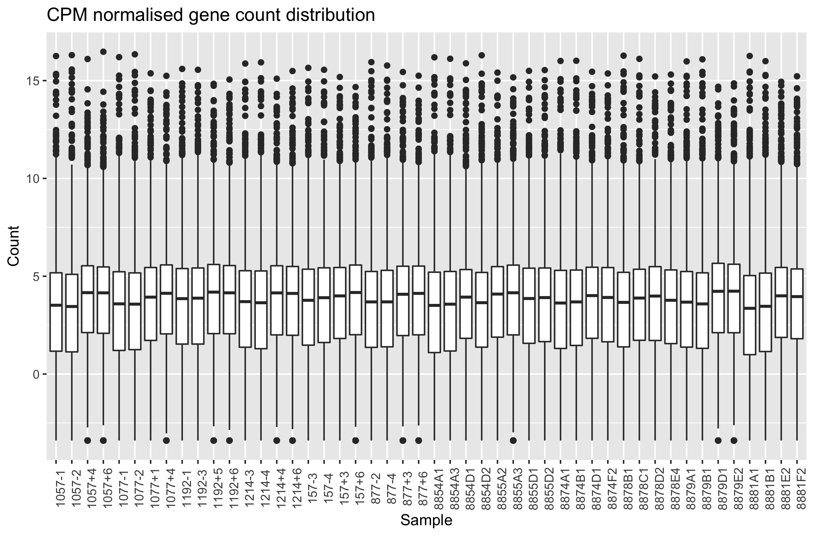
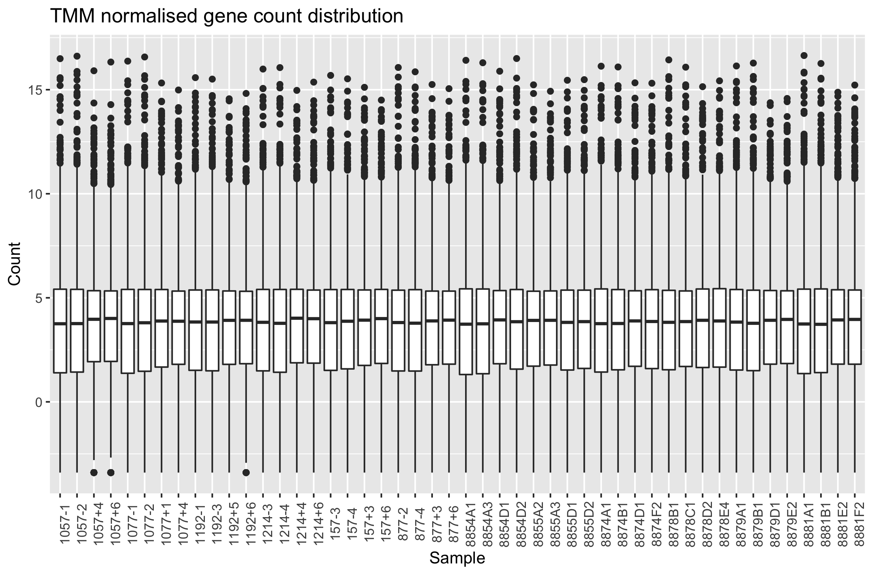
Read Normalisation (edgeR)
Calculate effective library size (account for library size differences between samples)
trimmed mean of log2 fold change between the two samples (M-value) (TMM)
Notes:
weighted trimmed mean of the log expression ratios:
trims gene-wise logfold changes and absolute expression levels before taking the weighted average
=> edge R does not use gene lengths because assumes that when comparing that doesn’t make a difference because the factor is on both sides (gene-wise comparison)

Slide 4
Overview Heatmap

Slide 5
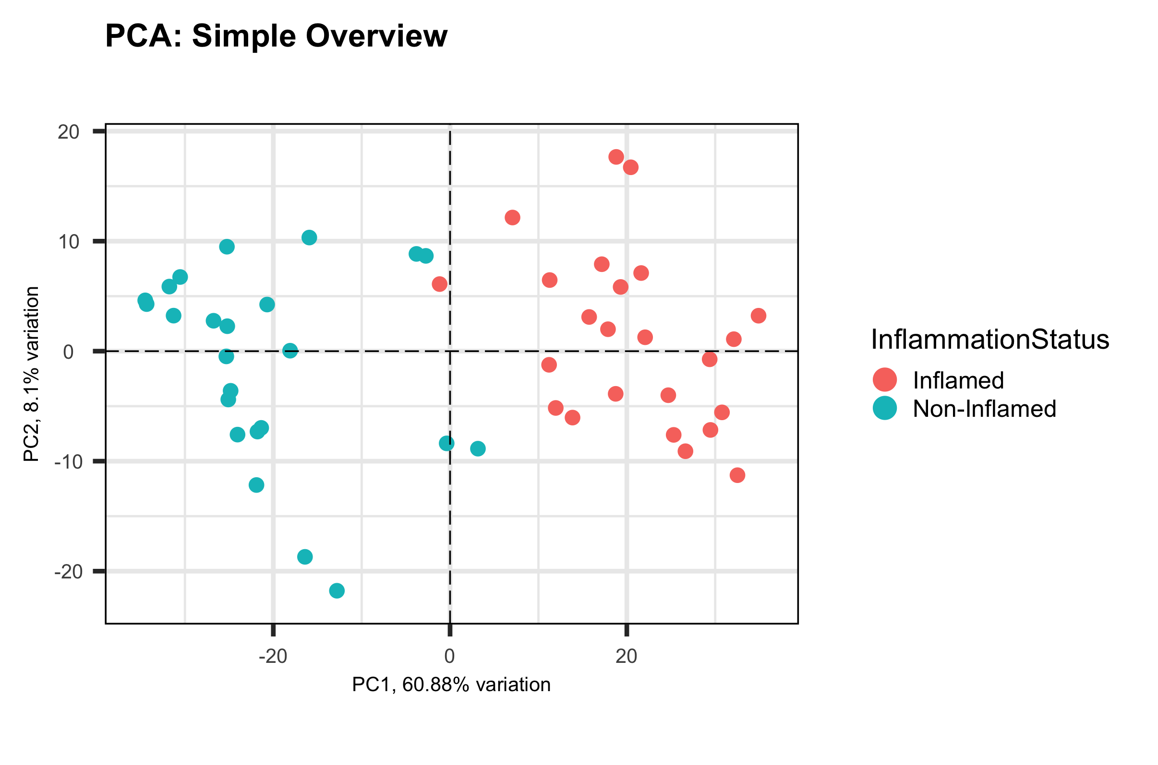
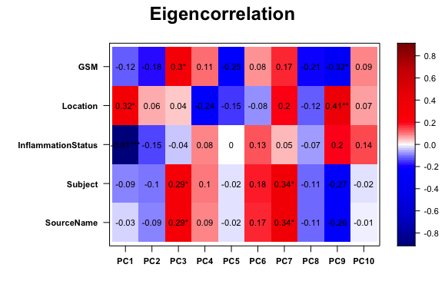
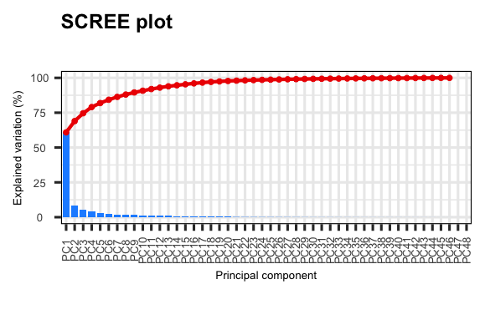
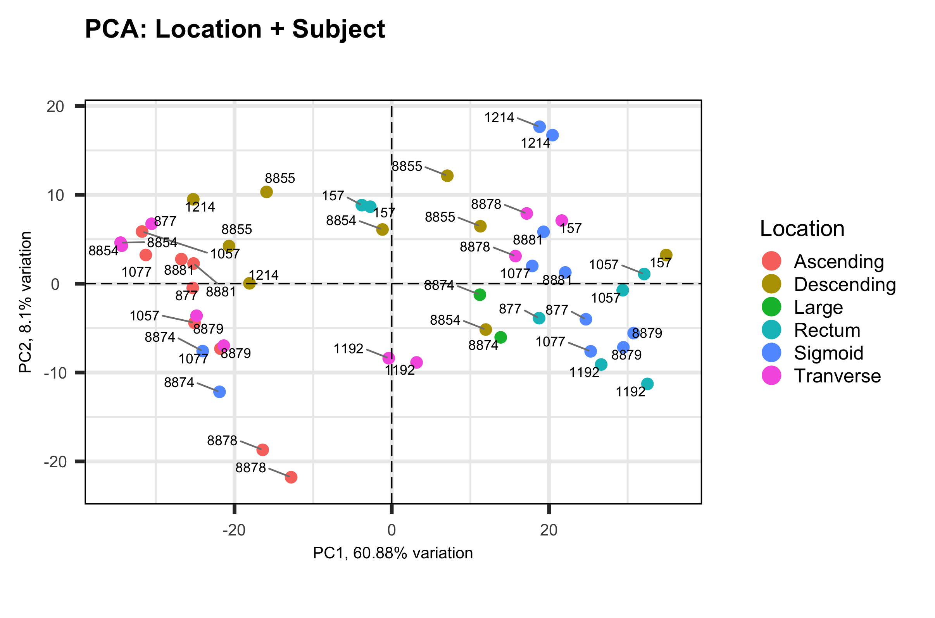
Principle Component Analysis (PCA)
Notes:
log transformed data

Slide 6
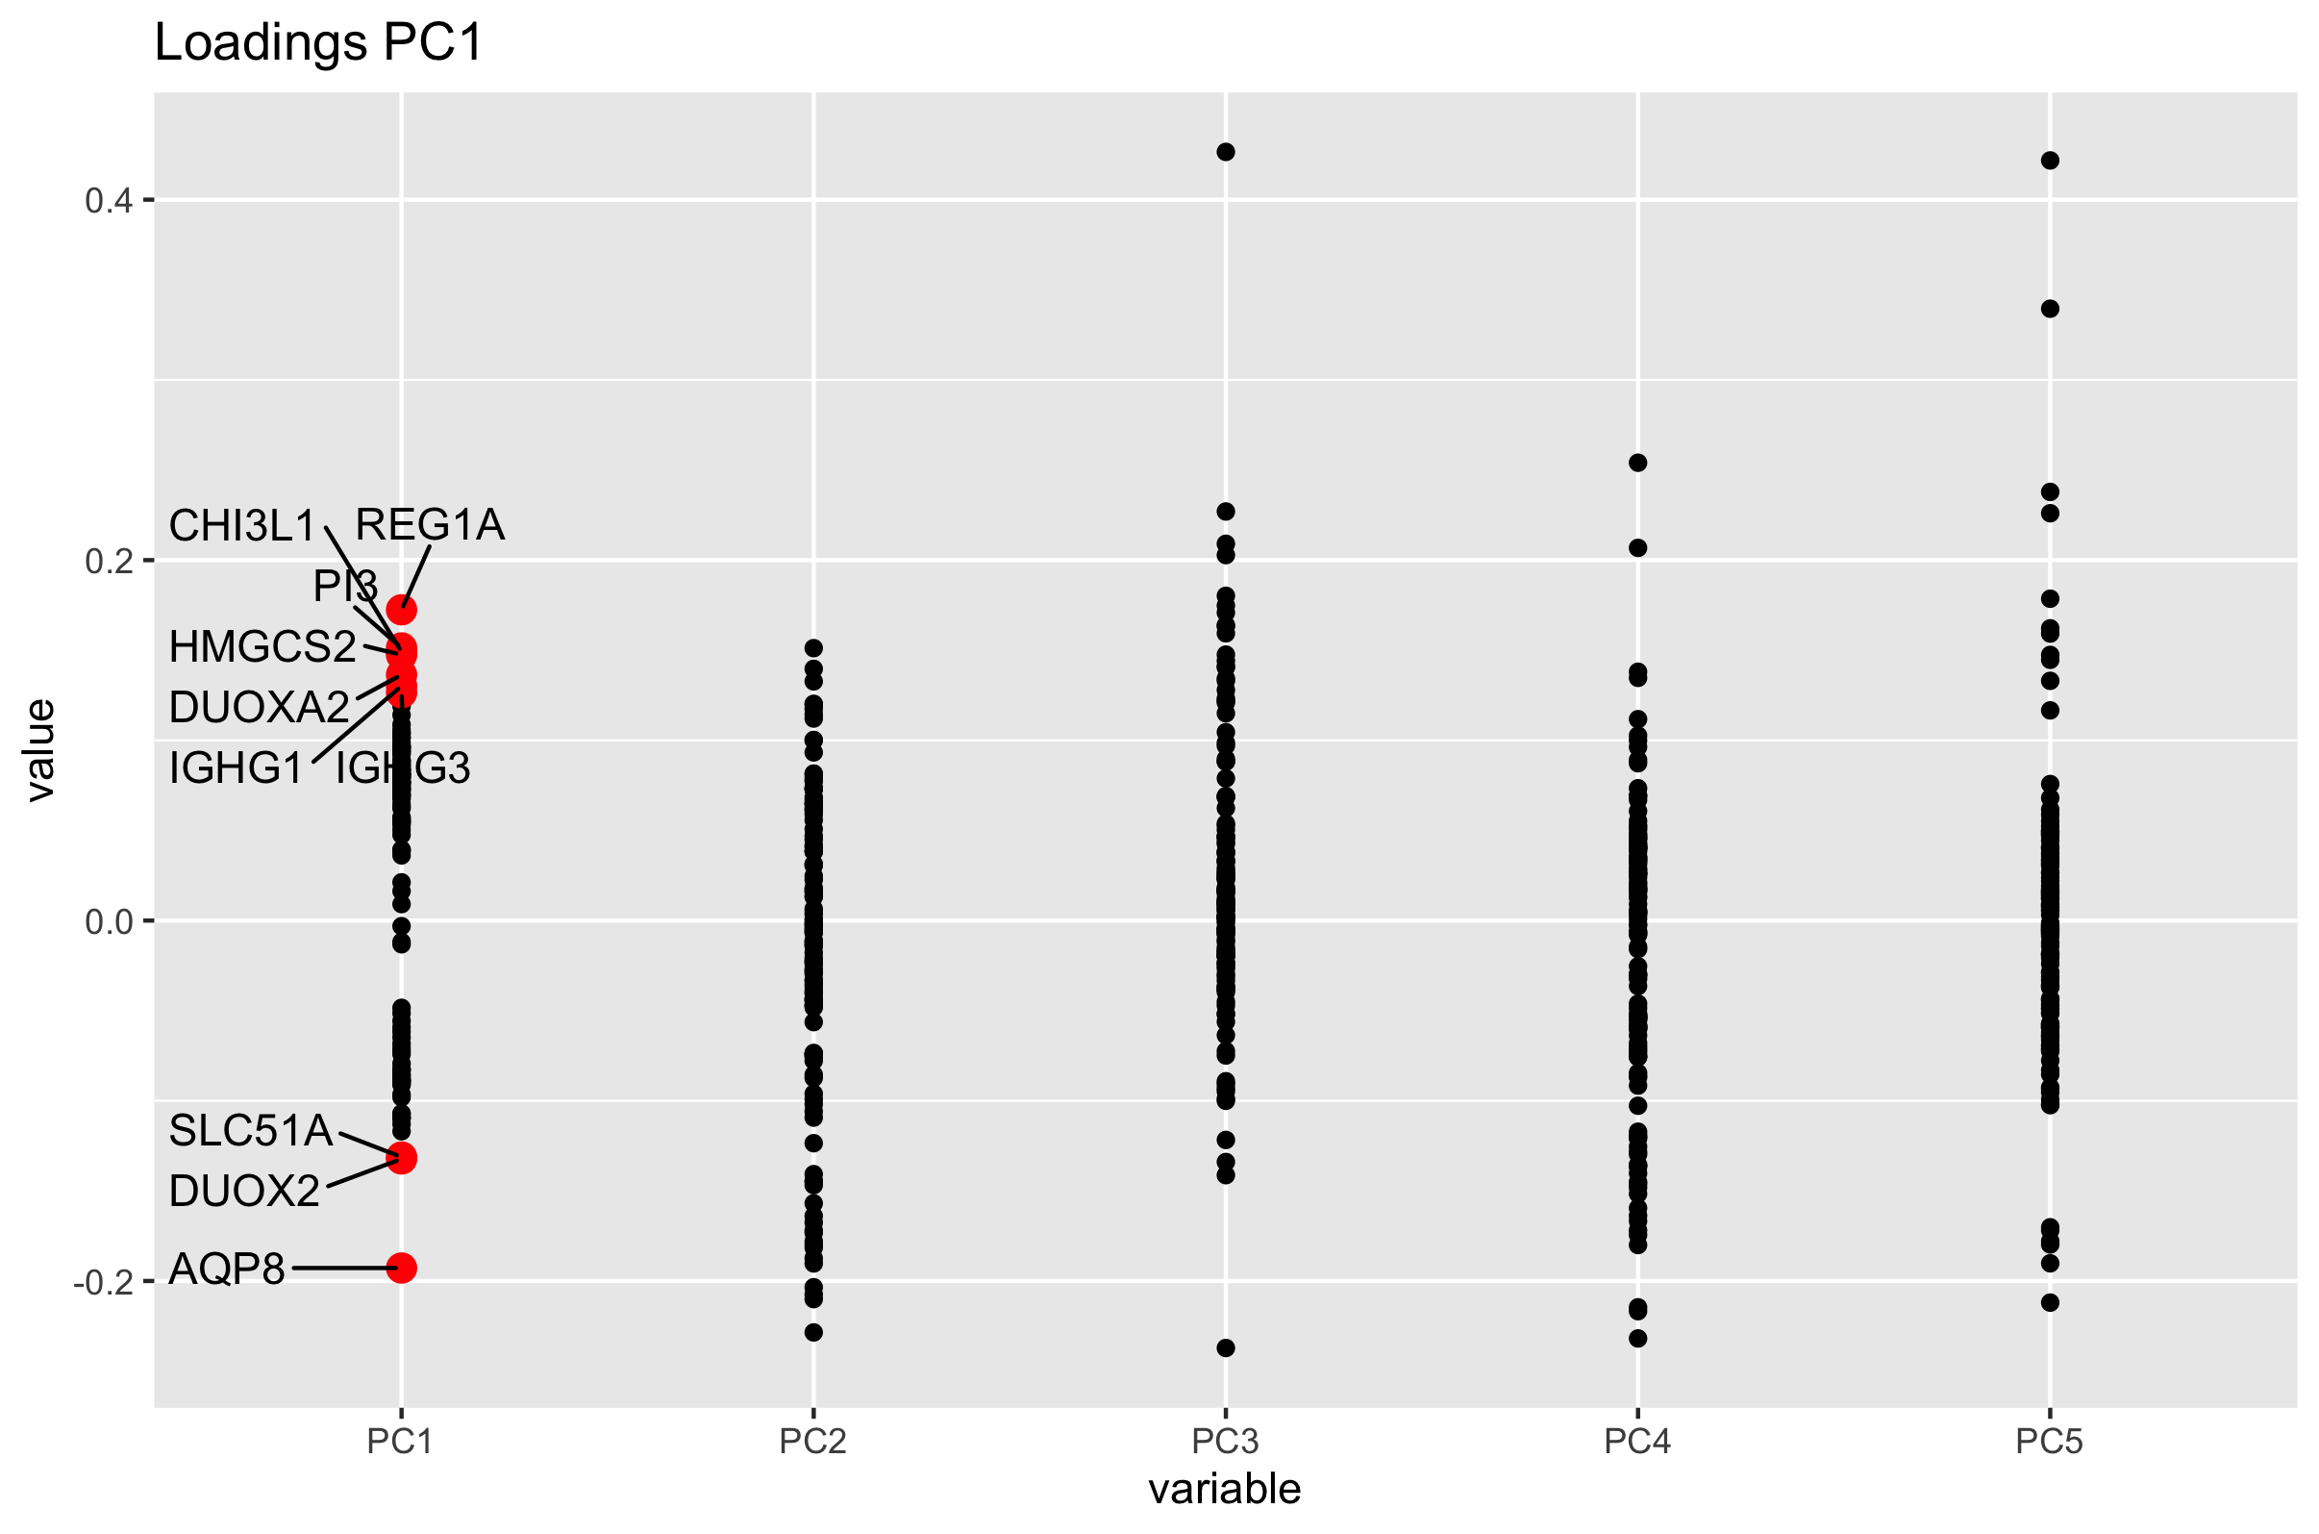
PCA: Principal Component 1
Loading | gene | gene_type | long name
-0.1928 | AQP8 | protein_coding | Aquaporin 8
0.1724 | REG1A | protein_coding | Regenerating family member 1 alpha
0.1513 | PI3 | protein_coding | Peptidase inhibitor 3
0.1490 | CHI3L1 | protein_coding | Chitinase 3 like 1
0.1474 | HMGCS2 | protein_coding | 3-hydroxy-3-methylglutaryl-CoA synthase 2
0.1364 | DUOXA2 | protein_coding | Dual oxidase maturation factor 2
-0.1323 | DUOX2 | protein_coding | Dual oxidase 2
-0.1312 | SLC51A | protein_coding | Solute carrier family 51 alpha subunit
0.1302 | IGHG1 | IG_C_gene | Immunoglobulin Heavy Constant Gamma 1
0.1264 | IGHG3 | IG_C_gene | Immunoglobulin Heavy Constant Gamma 3

Slide 7
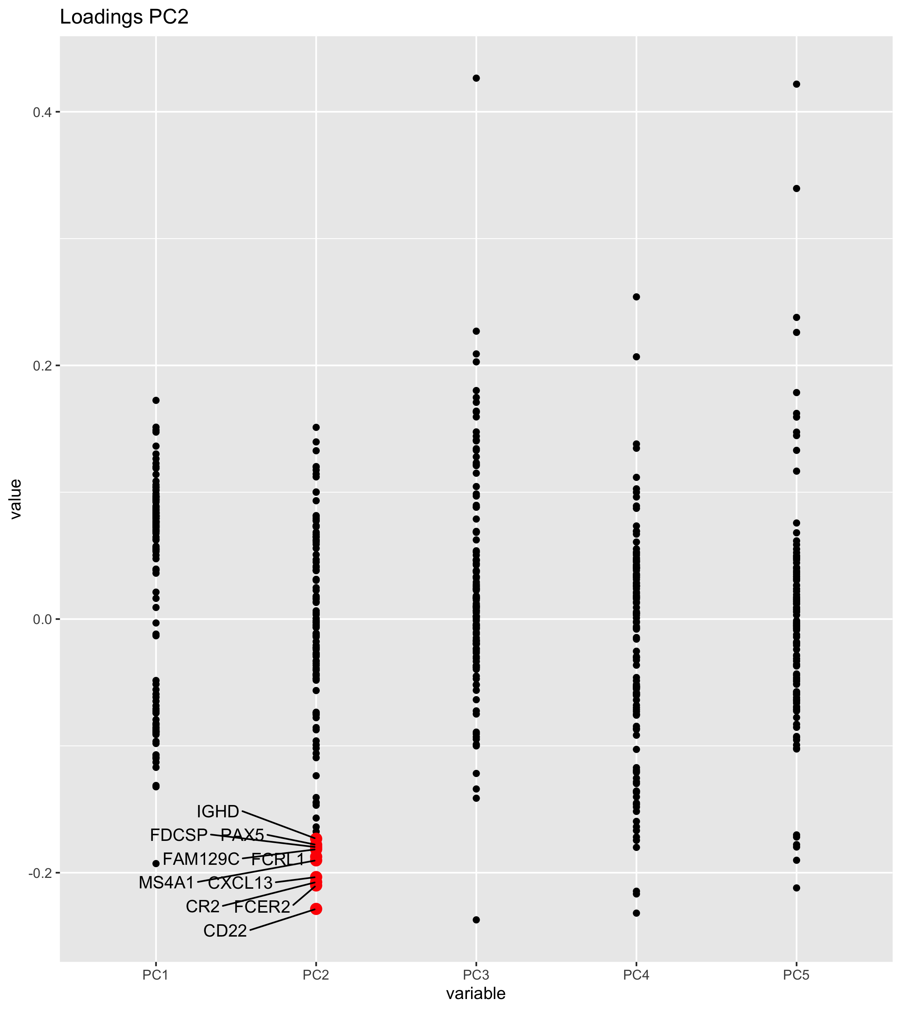
PCA: Principal Component 2
Loading | gene | gene_type | long name
-0.2285 | CD22 | protein_coding | -
-0.2101 | FCER2 | protein_coding | Fc fragment of IgE receptor II
-0.2074 | CR2 | protein_coding | Complement C3d receptor 2
-0.2034 | CXCL13 | protein_coding | C-X-C motif chemokine ligand 13
-0.1903 | MS4A1 | protein_coding | Membrane spanning 4-domains A1
-0.1874 | FCRL1 | protein_coding | Fc receptor like 1
-0.1816 | FAM129C | protein_coding | Family with sequence similarity 129 member C
-0.1798 | FDCSP | protein_coding | Follicular dendritic cell secreted protein
-0.1780 | PAX5 | protein_coding | Paired box 5
-0.1732 | IGHD | IG_C_gene | Immunoglobulin Heavy Constant Delta

Slide 8
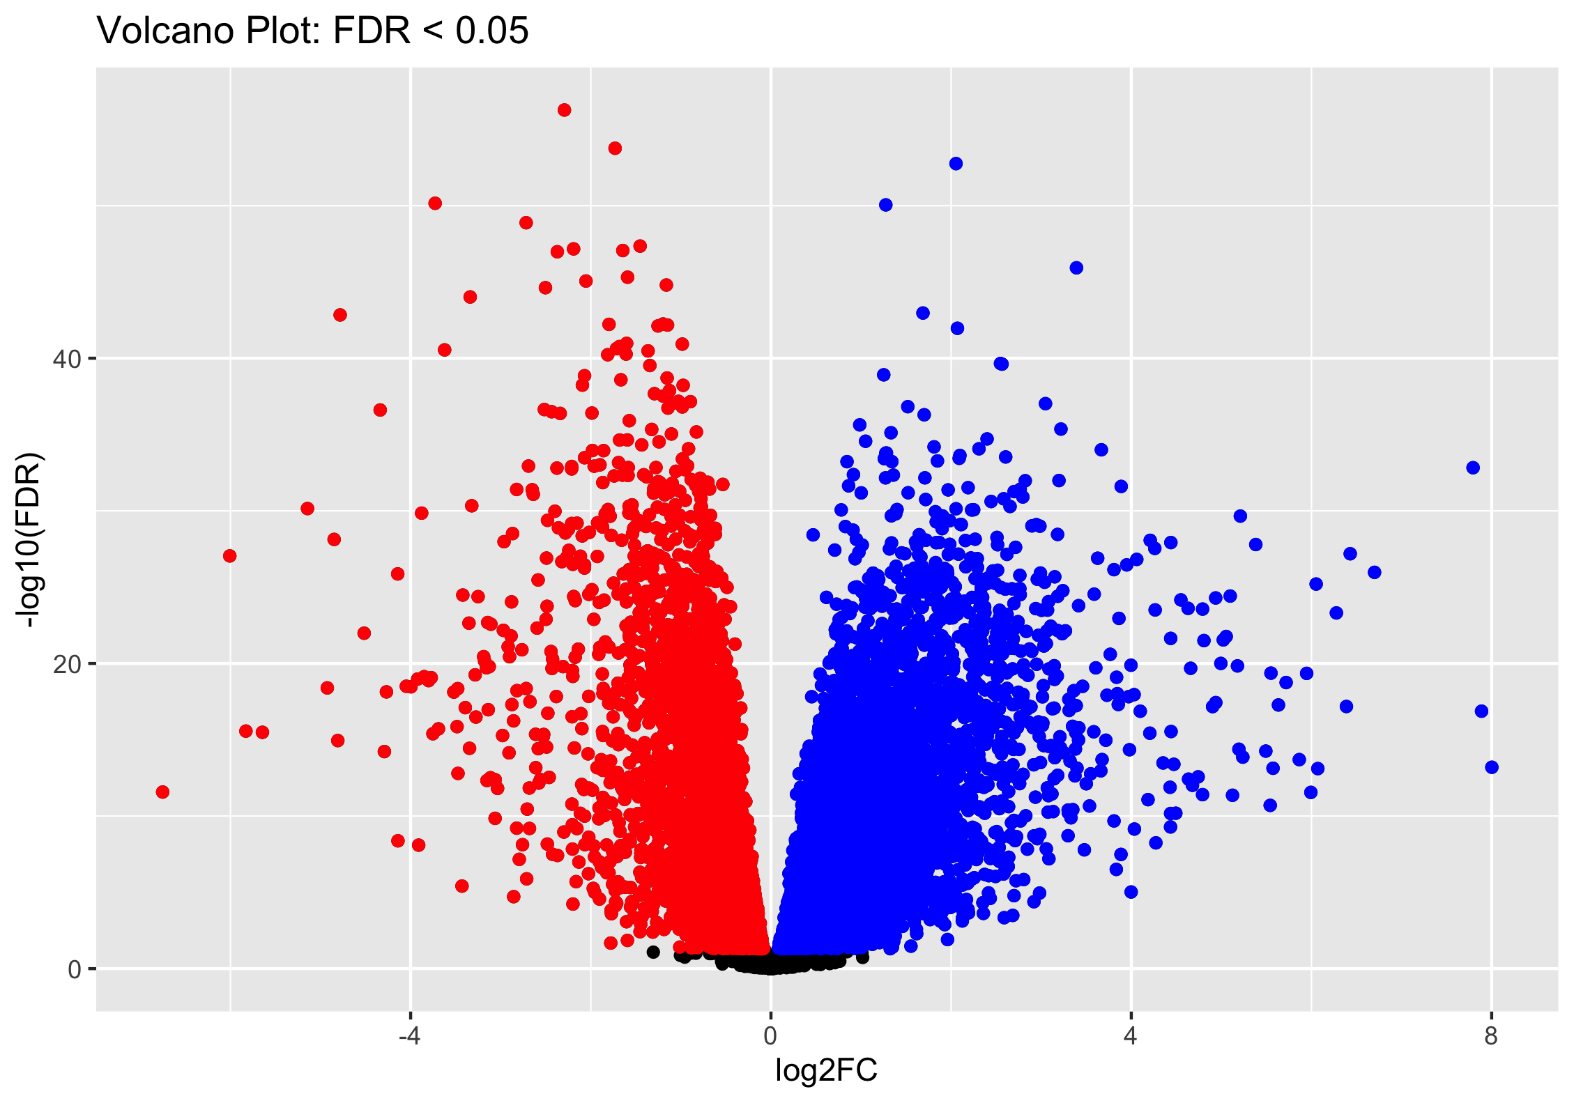
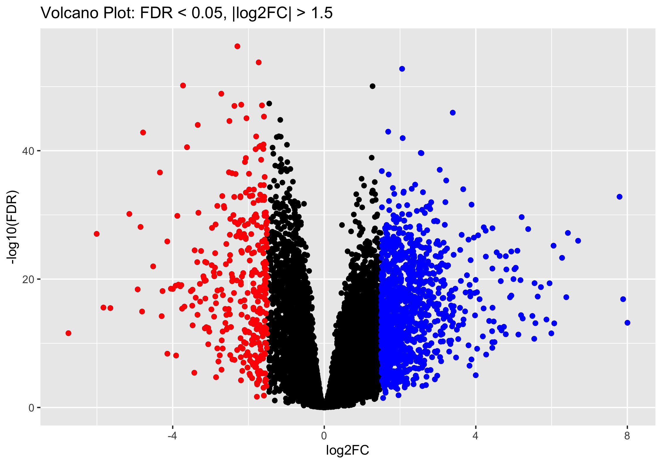
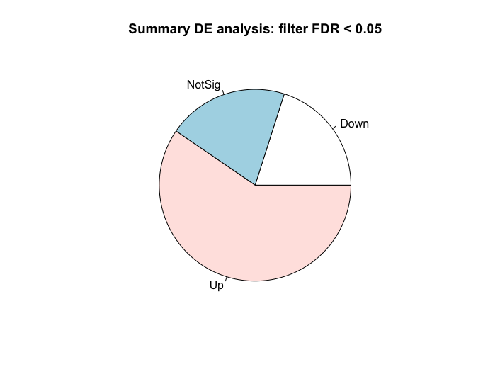
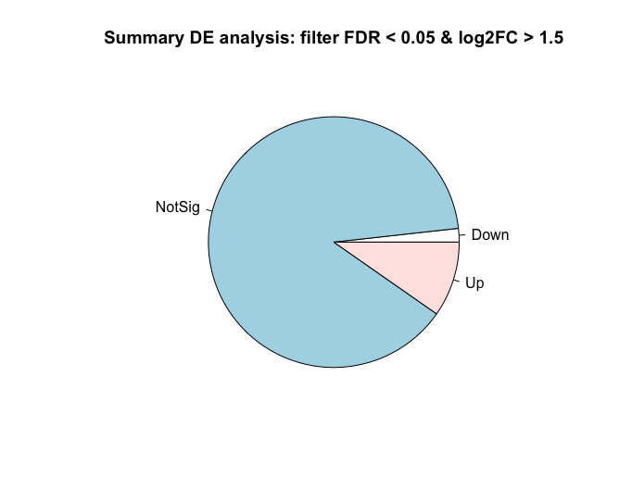
Differential Gene Expression Analysis

Slide 9
Differential Gene Expression Analysis
FDR > 0.05
FDR > 0.05, |log2FC| > 1.5
Notes:
KCNK5 & KCND3 : potassium channels
CDKN2B : cyclin dependent kinase inhibitor
ZNF: zink finger
NAADL: N-acetylated alpha-linked acidic dipeptidase
LRRN2: Leucine rich repeat neuronal 2
TMEM: transmembrane protein

Slide 10
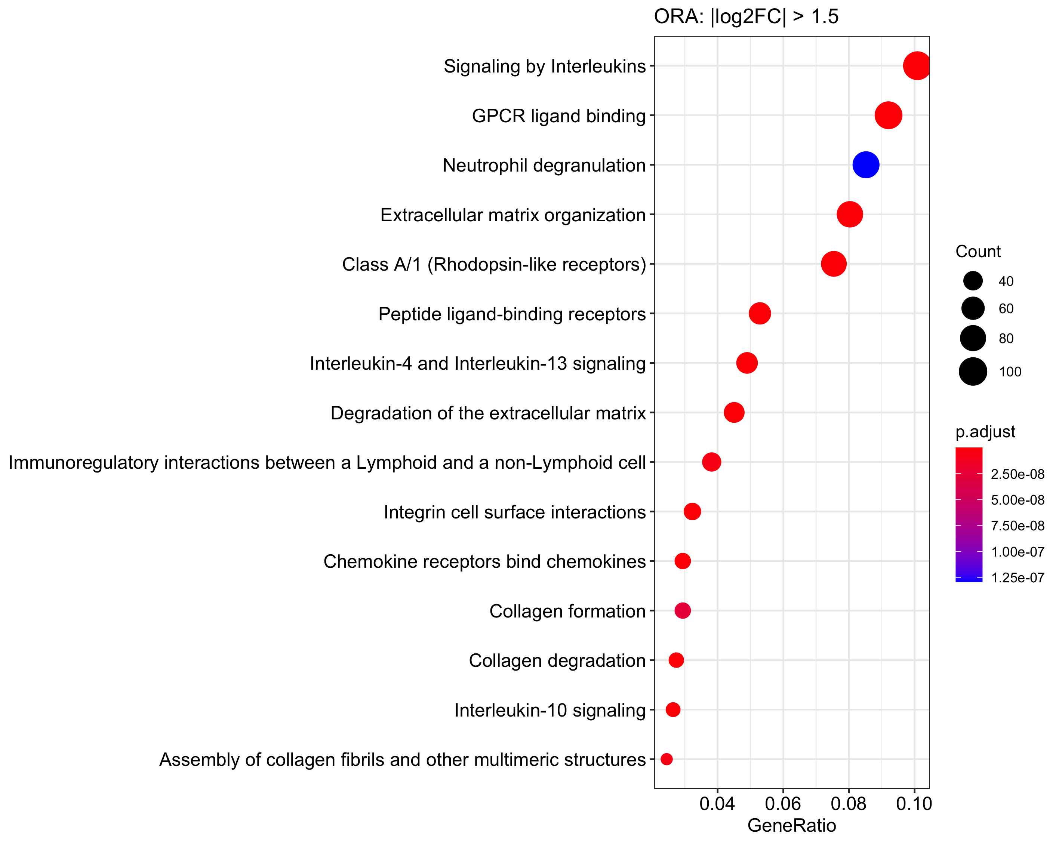
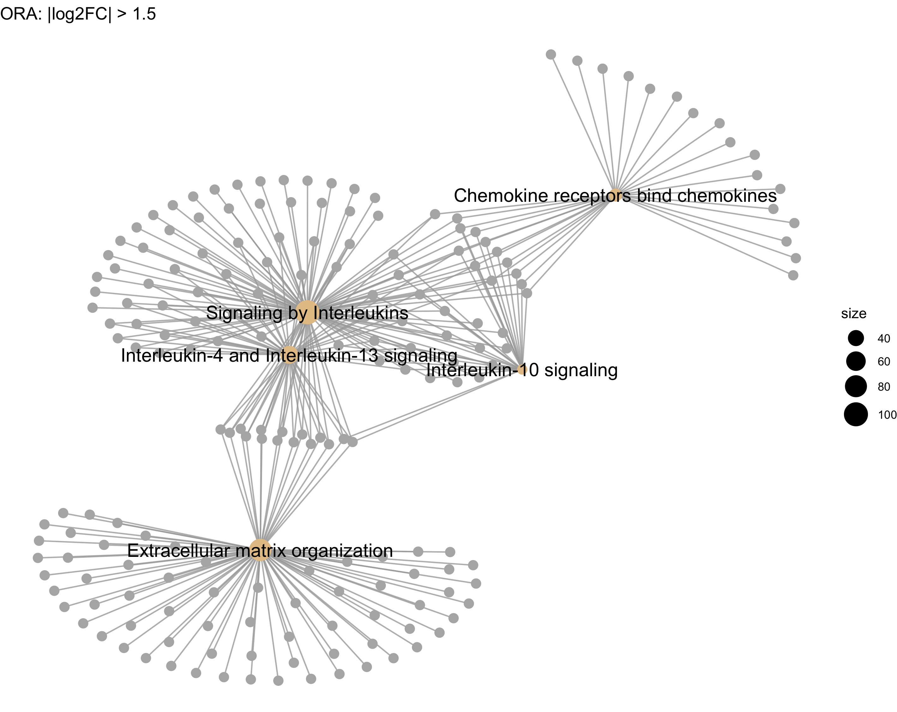
Over-representation Analysis

Slide 11
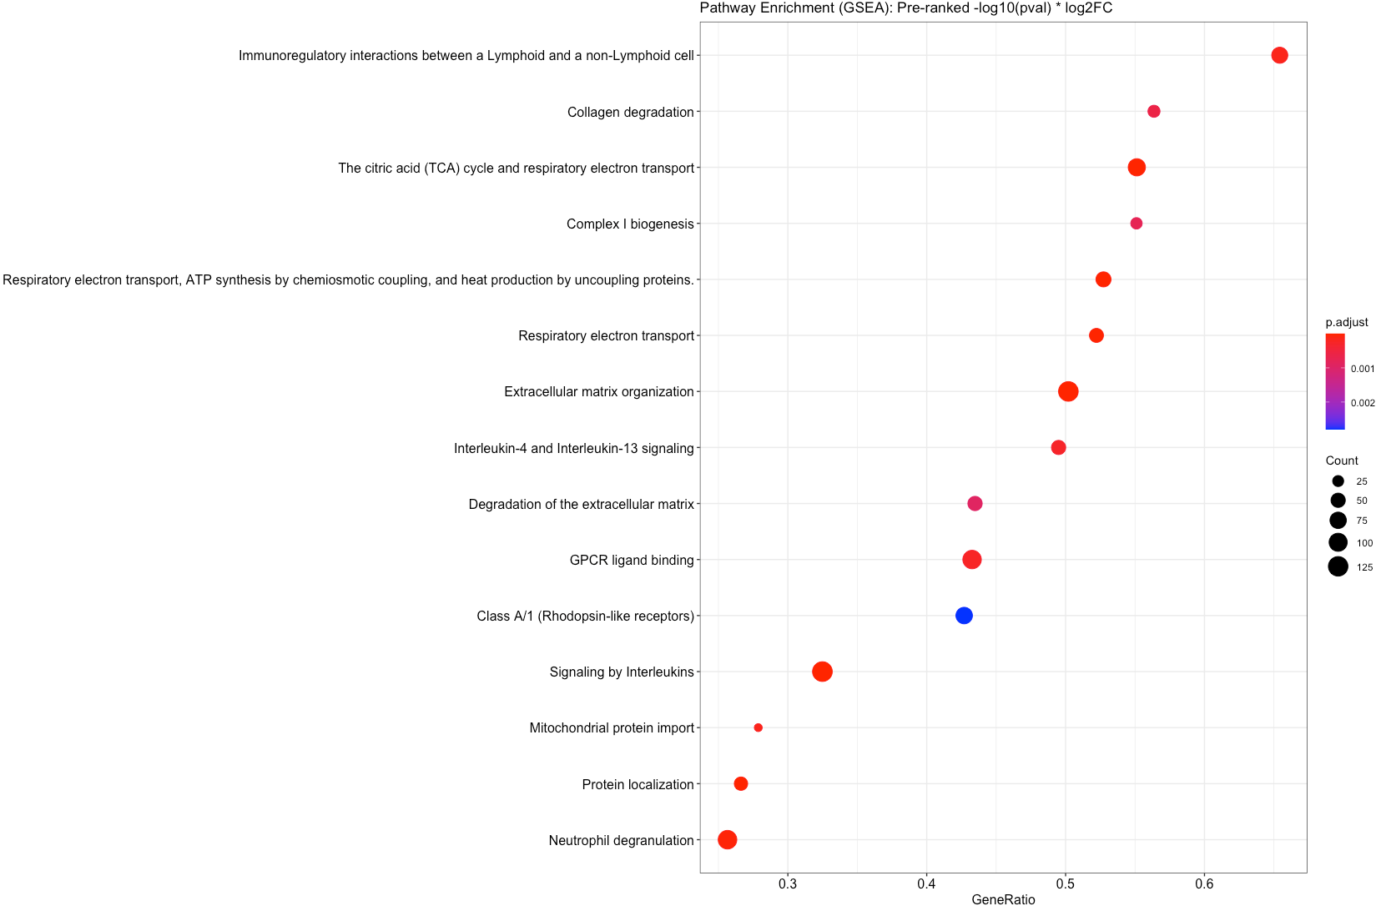
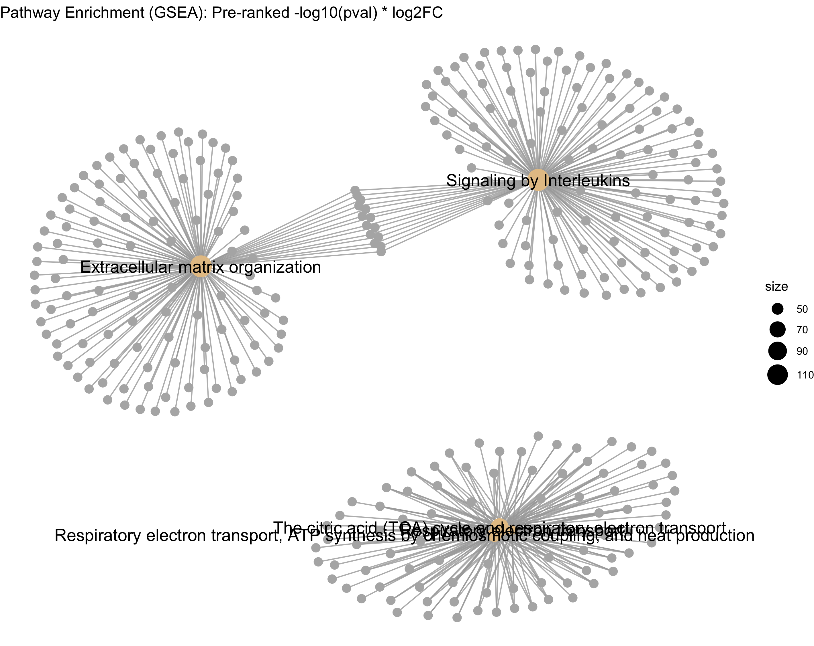
Gene Set Enrichment: Reactome
pre-ranking: -log10(padj) * log2FC

Slide 12
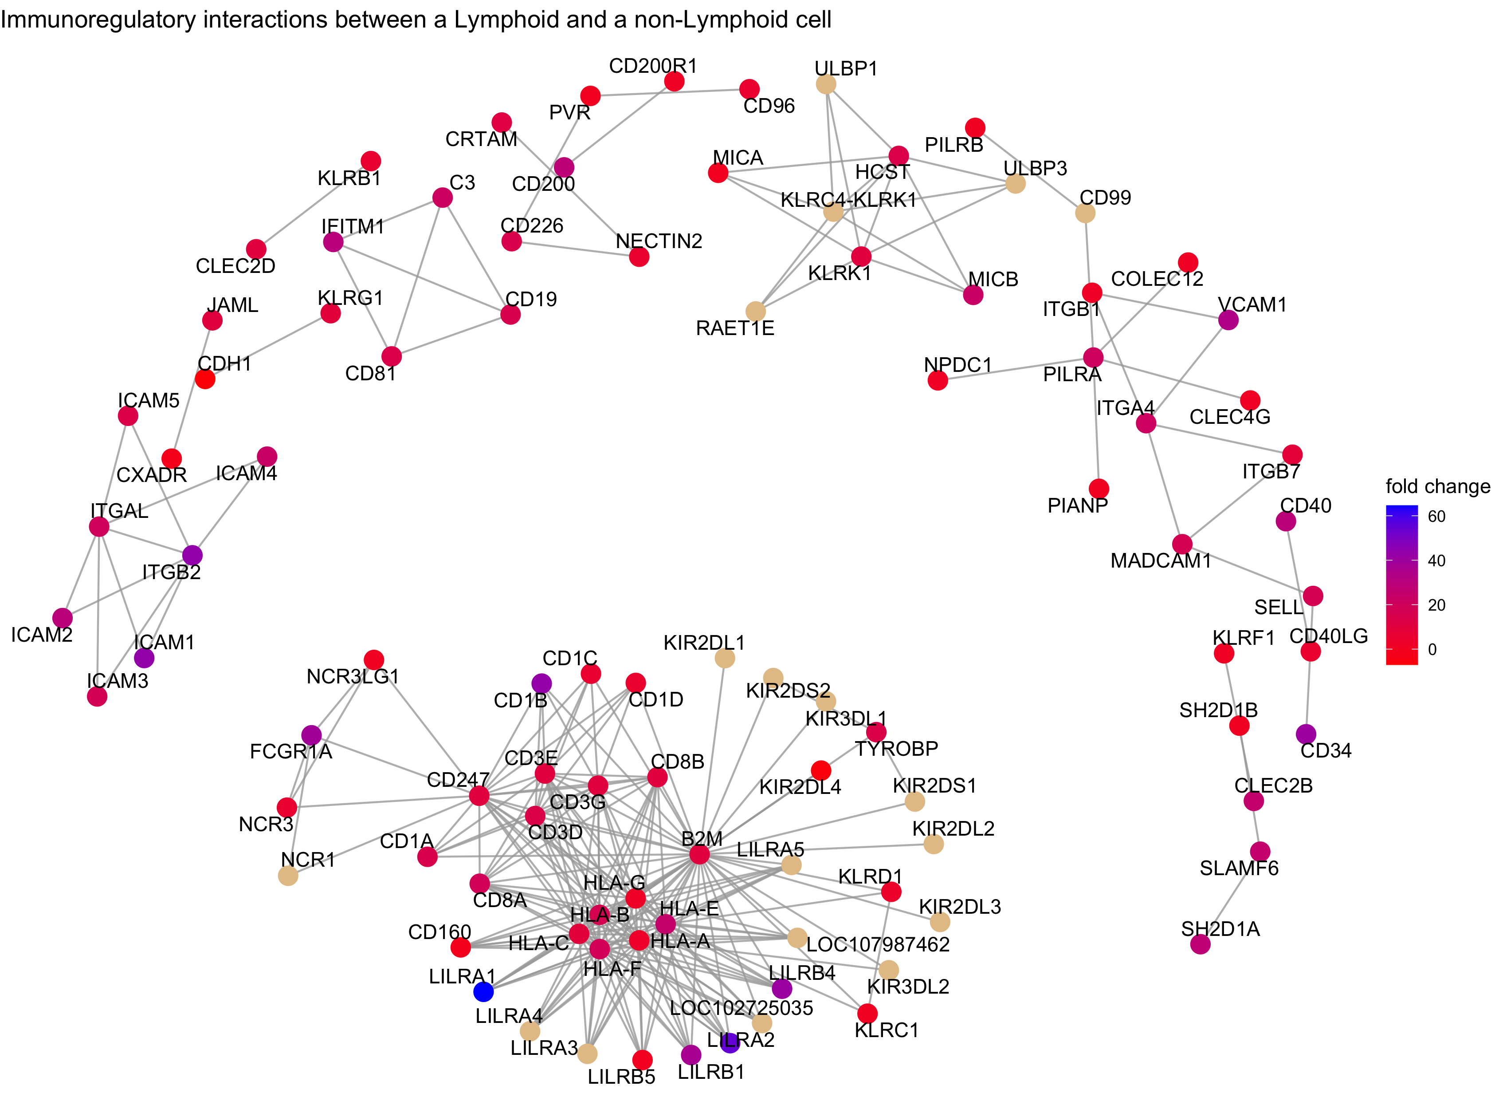
Gene Set Enrichment: Reactome
pre-ranking: -log10(padj) * log2FC

Slide 13
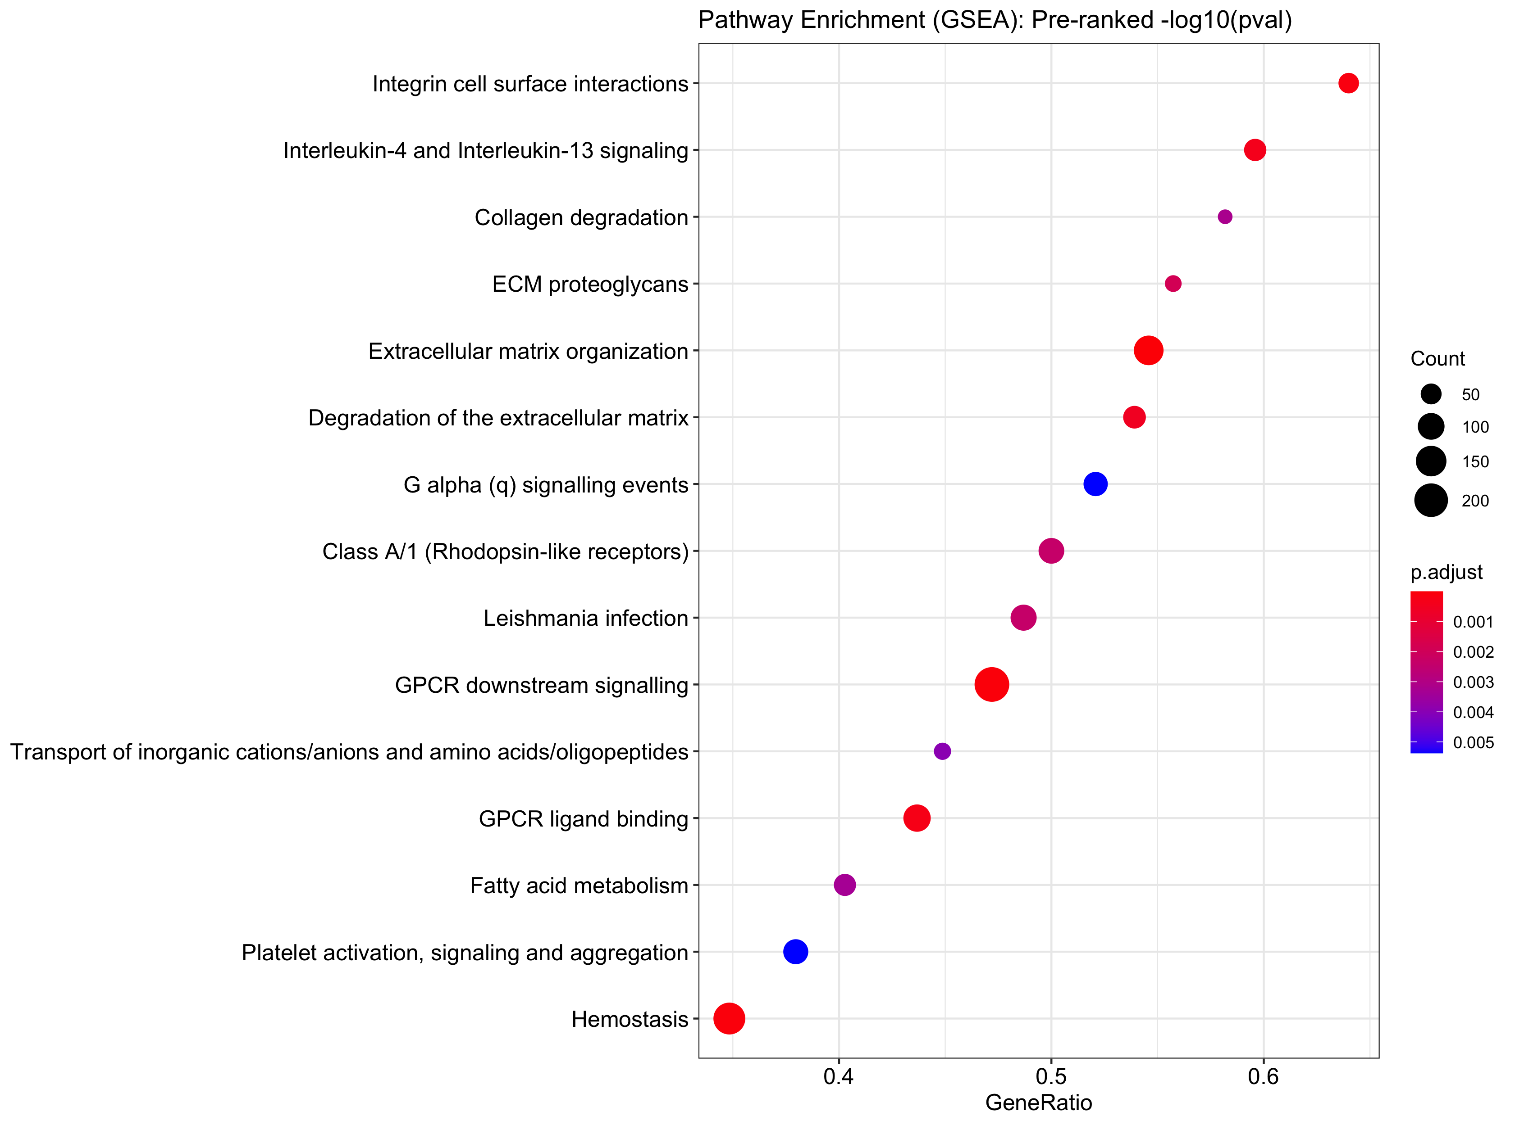
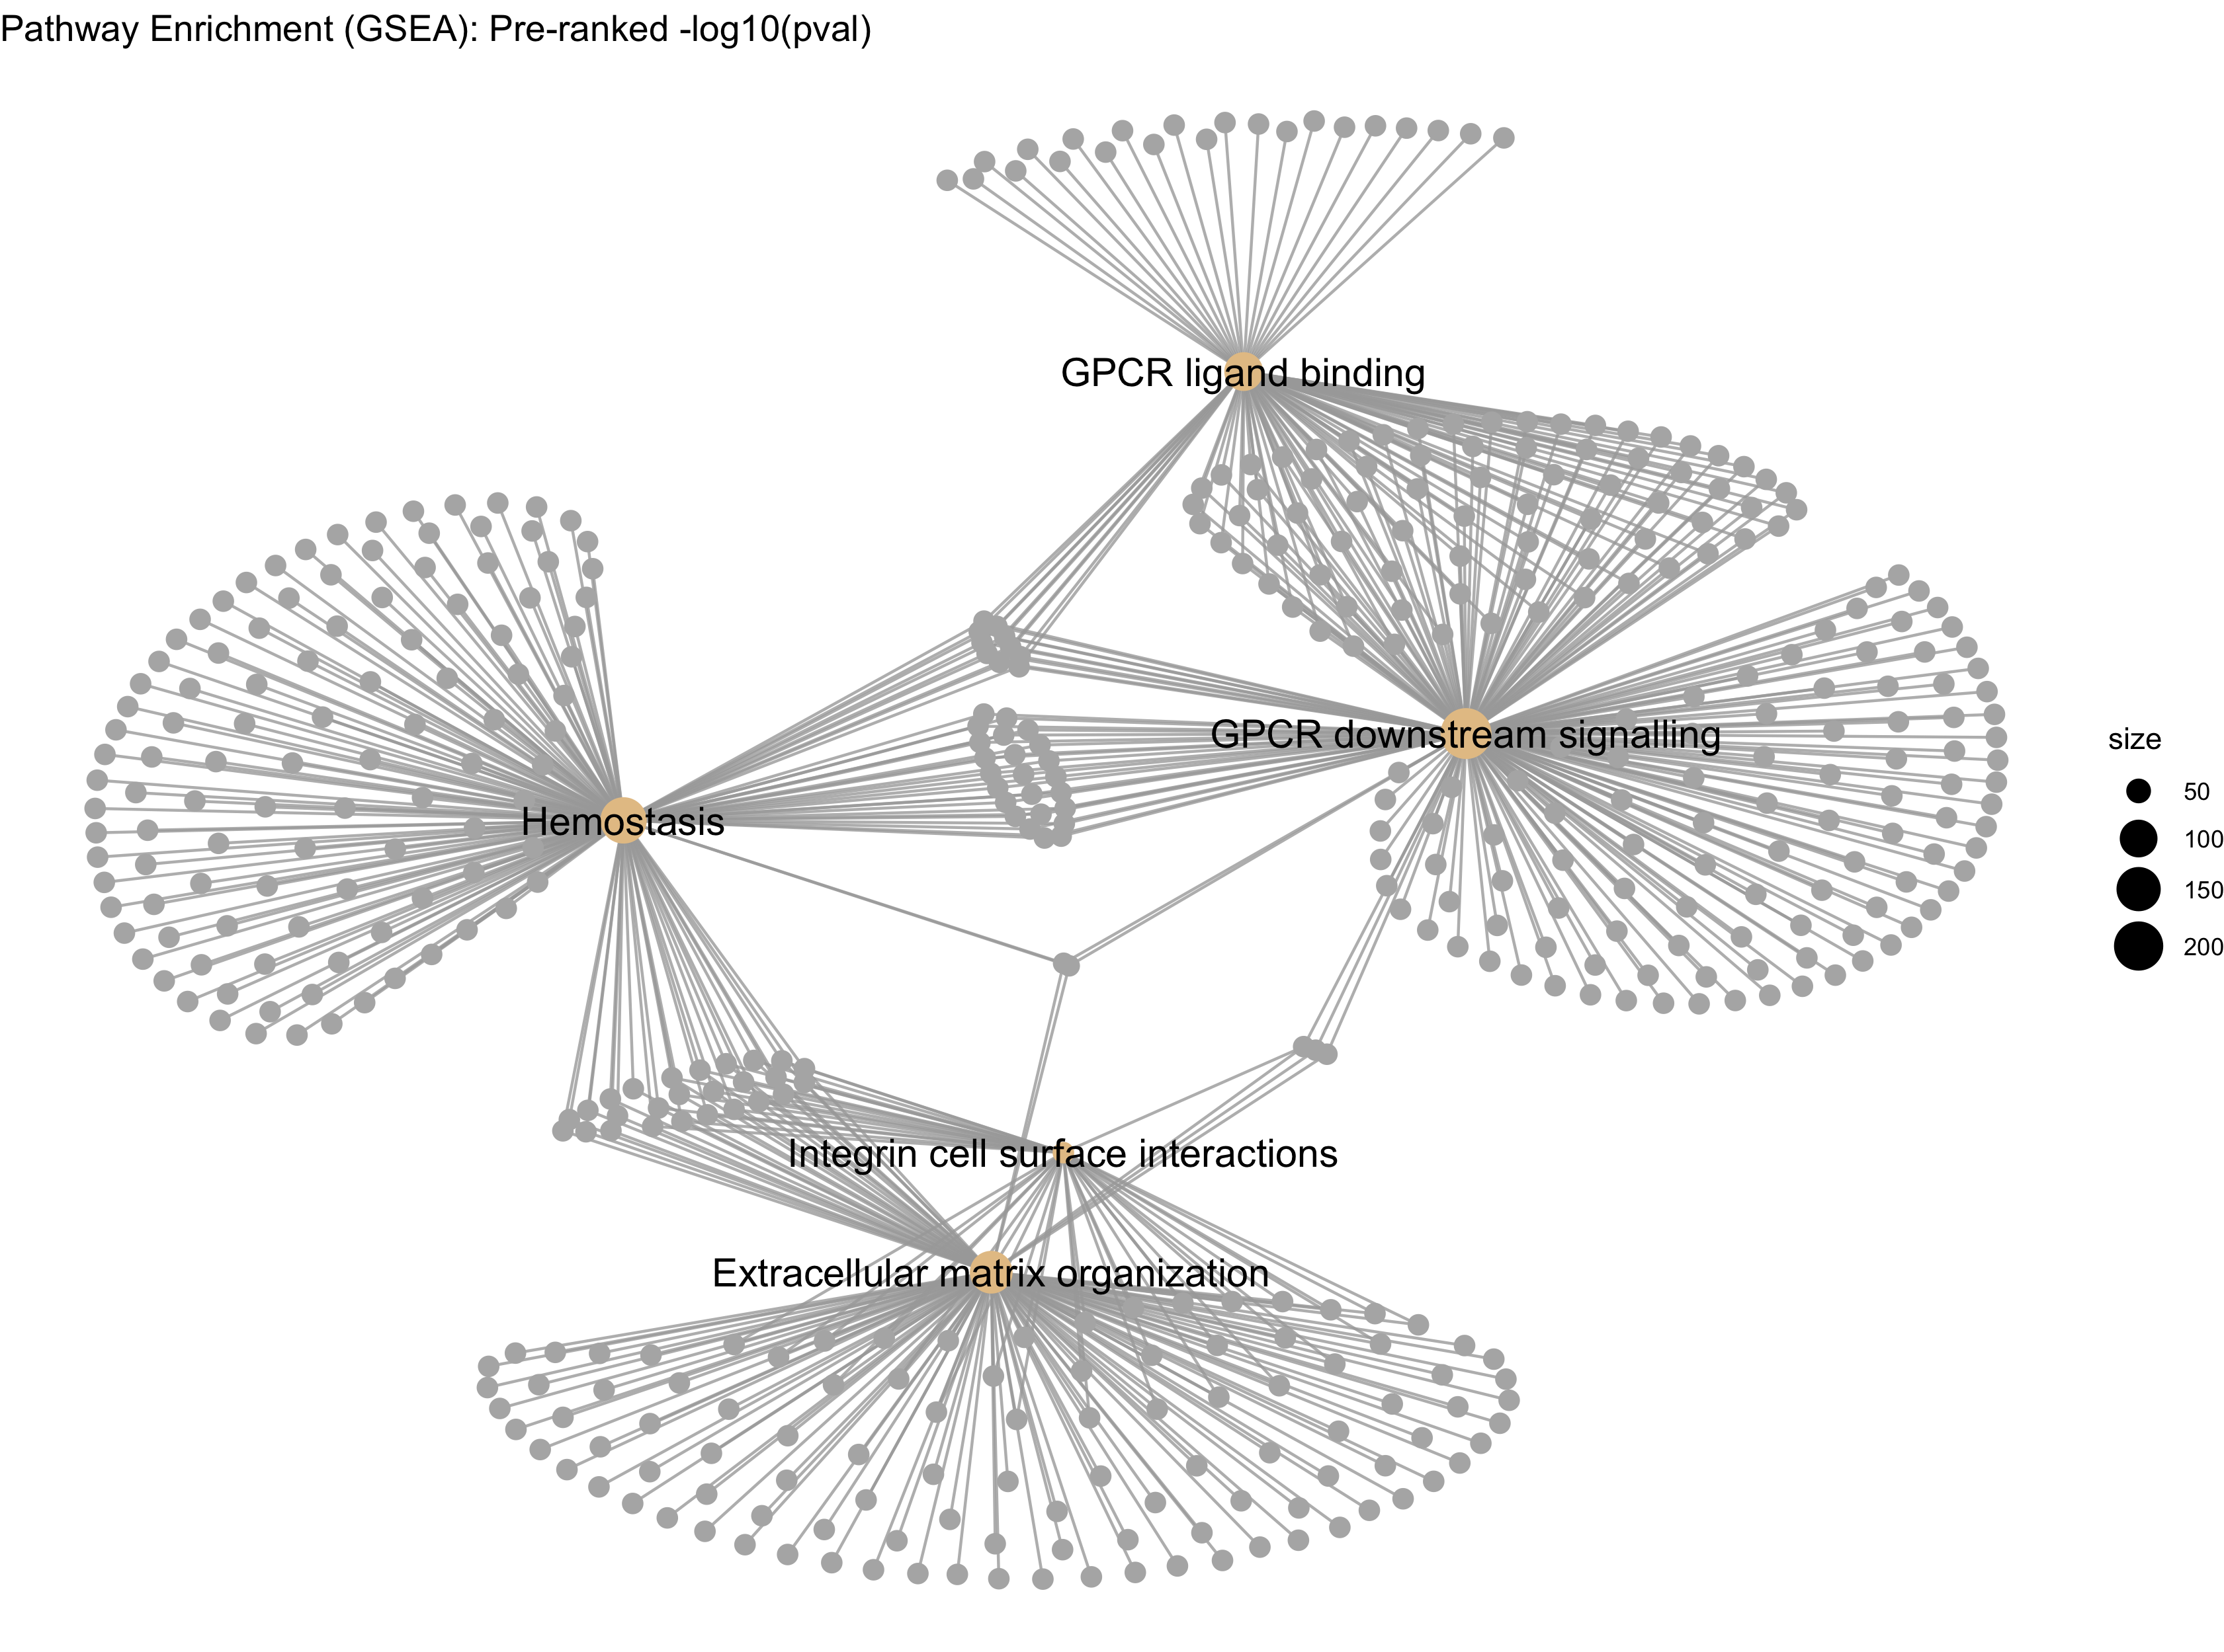
Gene Set Enrichment: Reactome
pre-ranking: -log10(padj)

Slide 14
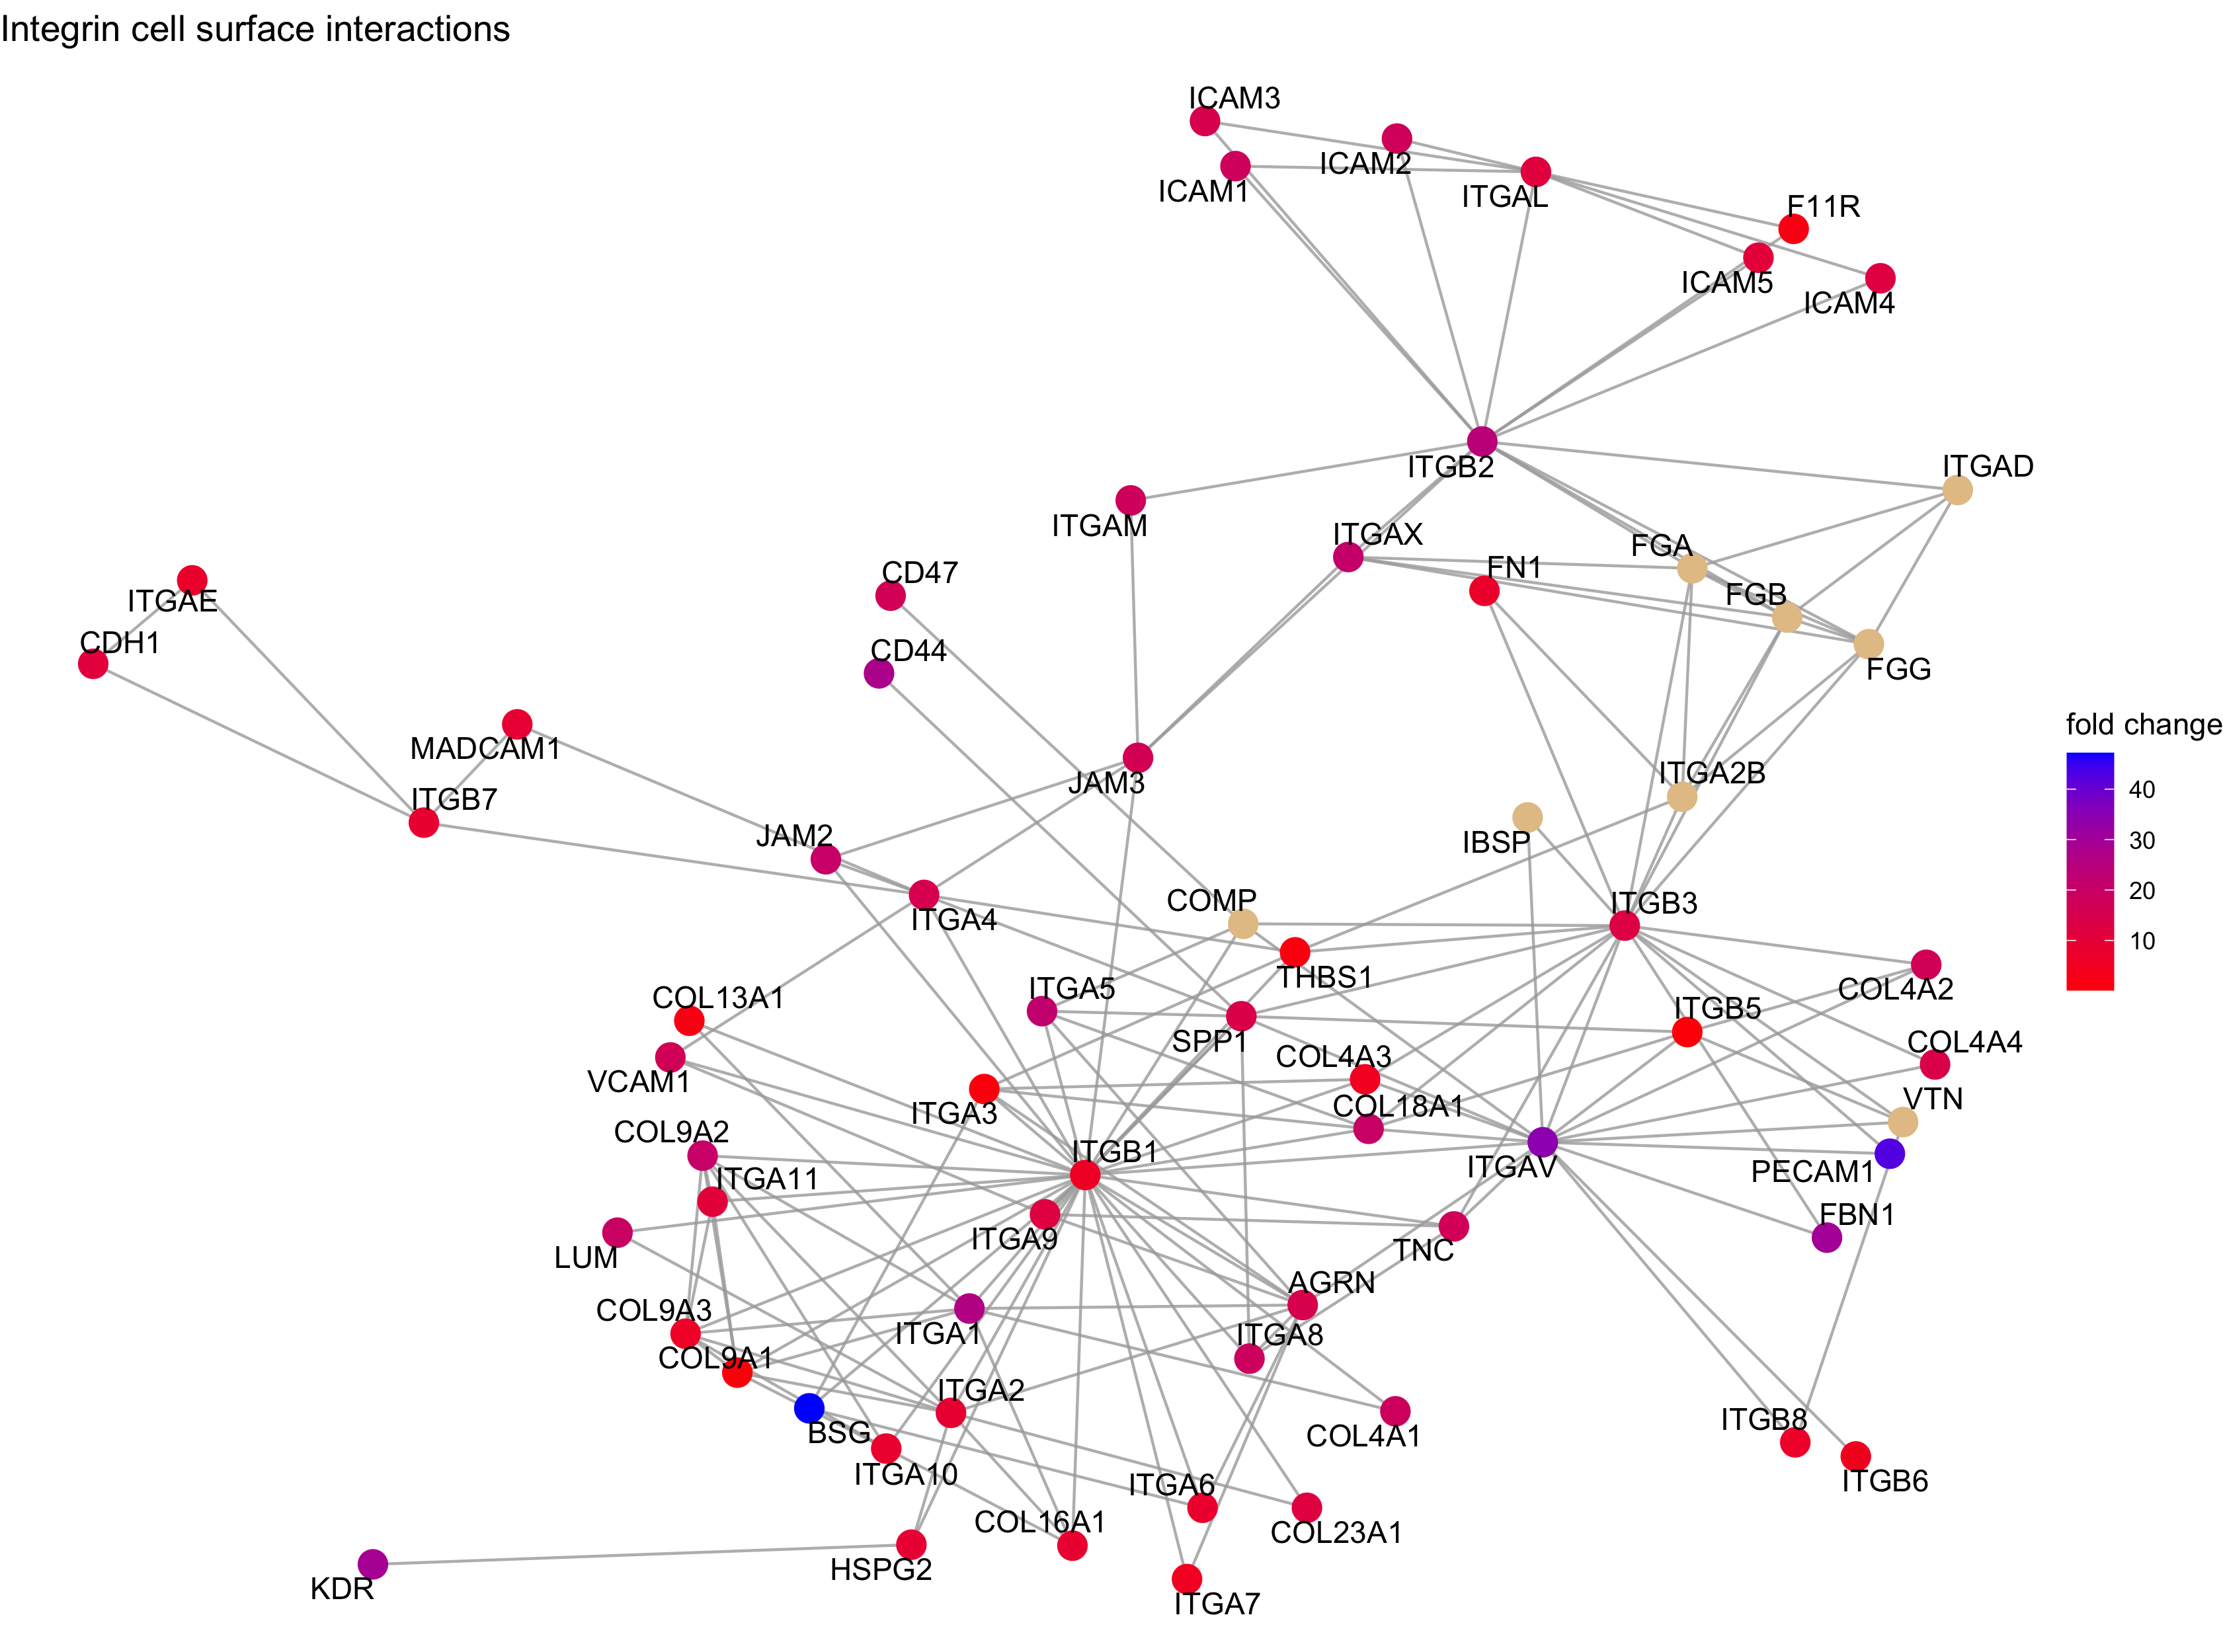
Gene Set Enrichment: Reactome
pre-ranking: -log10(padj)

Slide 15
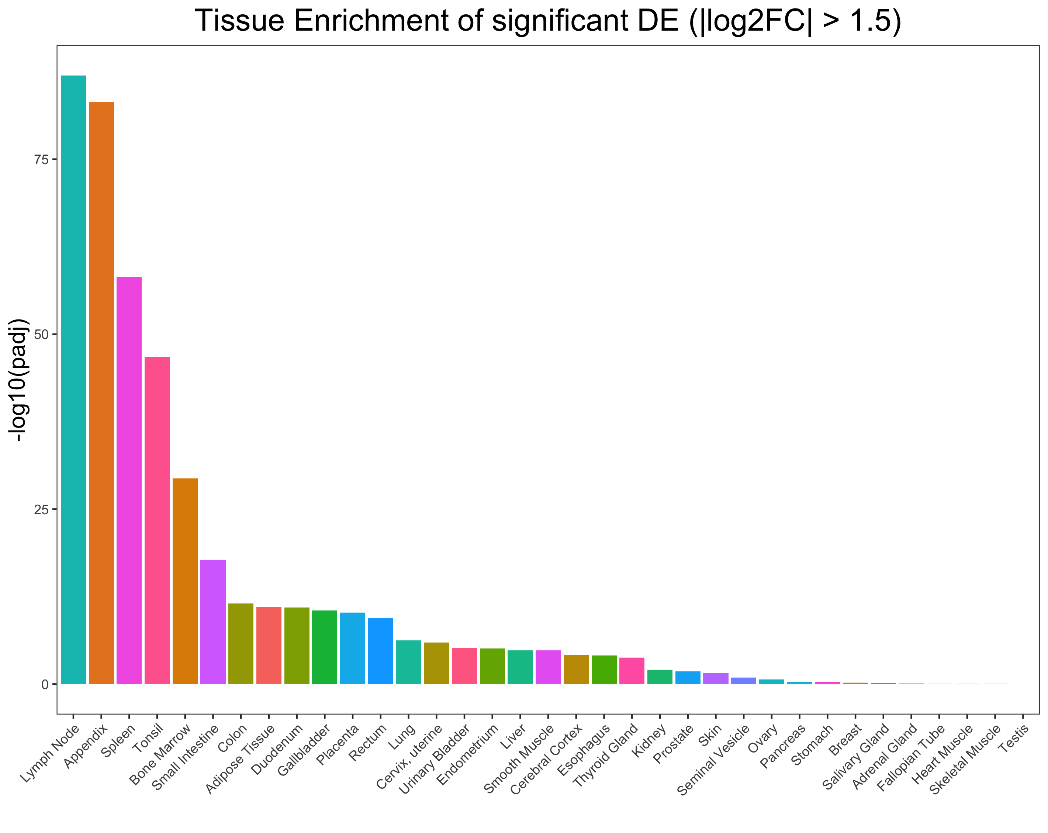
Tissue Enrichment

